Slide 1
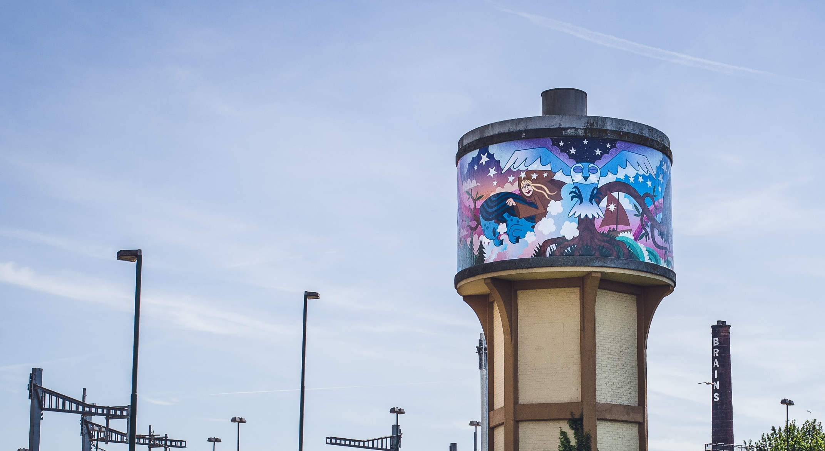

2020/2021
Organisational Report #5
Period covered: 1 April – 30 June 2020
The Weird & Wonderful Wales Cardiff Water Tower Mural

Slide 2
Contents
Updates, Highlights & Insights
COVID-19 Update…………………………………………………………….... 3
Organisational, Activity and Operational Highlights……………….. 4
Organisational Impact
The long-term change we will generate for Wales…………………. 7
Organisational Outcomes
The mid-term changes we will generate for our clients…………… 7
Organisational Outputs
Key Measures of Success relating to our Activity Pillars…………... 8
Measures of Success relating to our Operational Priorities……… 11
Evaluation
Organisational & Operational Learning Points…………………….. 16
Activity Learning Points…………………………………………….. 17
How to read this report
This report is an amalgam of the ACW Funding Requirements proforma (which focuses on our three Key Measures of Success plus one additional item) and our internal reporting requirements on both the organisational impact and outcomes we hope to achieve, plus our operational Measures of Success and Learning Points.
The targets featured are for year 2 (2020/2021) of the 4-year lifespan of the 2019-2023 Strategic Plan. These targets represent our ambitions, linked to the projects in our current activity and operational programme and current demographic, political, economic and social trends. Some of our projects are dependent on sourcing additional external funding, and some may be adapted or become unfeasible during the development process. Some projects will be affected by factors outside our direct control. For these reasons, these targets are a forecast of what success will look like and may be subject to reasoned revision.
The SLT receives this report plus another at a more granular project level which focuses on monthly progress towards project KPIs and project learning points. The Management Board can request to see this as required and may choose to do so periodically as best practice.
This report contains updated targets for 2020/2021. We considered our progress in year 1 alongside the uncertainty of our activity programme as a result of COVID-19 to distinguish a new set of organisational goals for year 2. In addition, rather than offering an accumulated progress, for this report we have instead provided an explanation for the altered targets.

Slide 3

COVID-19 Update
We have remained resilient and responsive during the COVID-19 crisis.
Although we initially postponed much our activity, we continued to inspire communities, develop writers and celebrate the literary culture of Wales by adapting some existing projects to fit new delivery methods, as well as developing new initiates to fit altered client needs.
Our Children’s Laureates continued to engage and inspire the children of Wales through exciting weekly challenges. The laureates have also been involved in a variety high-profile events, such as the celebration of 20 years of Bardd Plant Cymru at Tafwyl, and a feature on our Children’s Laurate in The Bookseller.
We commissioned 20 writers from a range of backgrounds and career levels to deliver content to entertain, inspire and educate creative audiences and writers across Wales. From poet interviews on YouTube, an interdisciplinary remix on race and identity and masterclasses on how to get an agent, the artistic creators have stimulated literary activity for a variety of audiences to access. The active commissions have already reached over 500 people, and our communications promotions have earned over 50,000 impressions across our main social media channels.
Tŷ Newydd Writing Centre has remained closed, but we have continued to programme activity associated with our valued brand. New initiatives include the launch of the first ever Virtual Courses offered at a low-cost to ensure widened accessibility. Within two weeks of the announcement, we received over 50 bookings. The short courses feature some of Wales’ best writers including Sunday Times bestselling psychological thriller writer, Clare Mackintosh, who’s course sold out in under 24 hours.
Finally, we are in the final stages of working with BBC Wales to announce the Wales Book of the Year shortlist live on air. We will continue to work with partners to develop exciting content, including panel discussions, readings and interactive activities, to platform and engage the vibrant literary community here in Wales and beyond.
Visitor World Map at Tŷ Newydd Writing Centre

Slide 4


Highlights
Organisational
We contributed 50% of our earmarked lottery funding for 2020-2021 to the Arts Council of Wales’ Arts Resilience Fund in response to the COVID-19 crisis.
We provided in-kind support and funding to the Wales, Race and Culture Task Force, which aims to research, challenge and advise the arts and cultural sector on equality and diversity.
Activity
20 freelance writers commissioned to devise and create original digital content and projects for audiences following two call-outs, the second in collaboration with the Royal College of Psychiatrists in Wales.
Seven poets awarded a place on our Digital Poetry Master Class with Gillian Clarke to celebrate the 30th anniversary of Tŷ Newydd as the National Writing Centre of Wales.
Bardd Plant Cymru scheme celebrates its 20th anniversary with a lively discussion on experiences within the role with current laureate, Gruffudd Owen, and two former laureates Casia Wiliam and Ifor ap Glyn.
Wales Book of the Year announced to take place this summer in a new digital format.
First ever programme of Tŷ Newydd Writing Centre virtual courses for summer 2020 launched.
Multilingual event ‘Mothertongues’ delivered in collaboration with British Council Wales, Welsh Government and British Council Ireland at the Cúirt International Festival of Literature.
New project cross-artform ‘Weave | Plethu’ launched in collaboration with National Dance Company Wales.
Operational
Literature Wales teamed up with Newport Mind and Community House, Maindee Youth Project on a Comic Relief funded project after a successful fundraising bid.
Stakeholder surveys launched to gain audience insight into our response to COVID-19, general activity programme and Marketing & Communications channels with over 460 responses.
A range of digital MARCOMMs resources created and distributed to encourage children, young people and adults to share their lockdown reading activities.
Successful 2 phase fundraising pitches submitted to Clwstwr for a video game development project based on Welsh literary myths and legends.

Slide 5
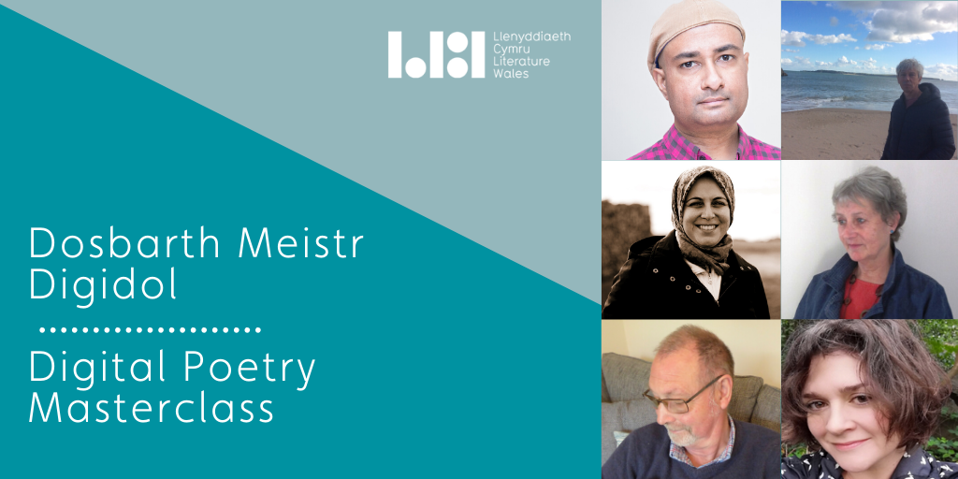
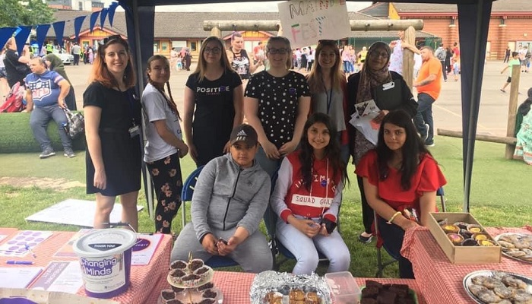
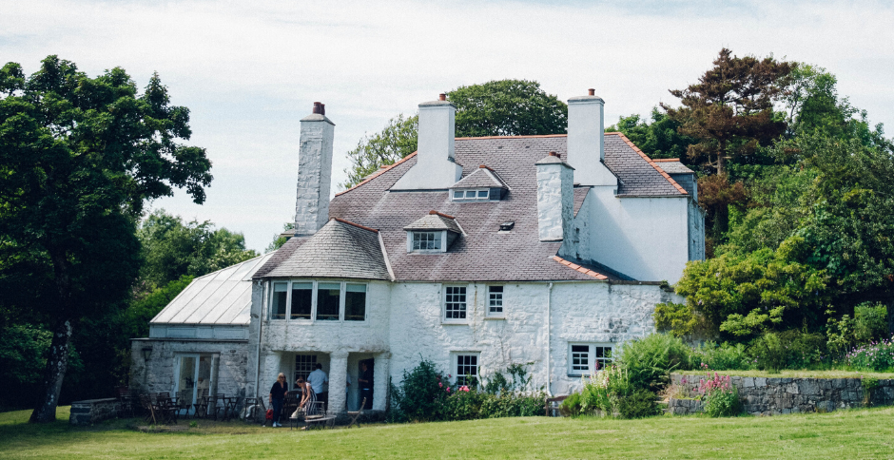






7 Poets awarded a place on our Digital Masterclass with Gillian Clark to celebrate the 30th anniversary of Tŷ Newydd.
Successful fundraising bid secured for a participatory project with Newport Mind and Community House
Debut Welsh-language Writing for Young Adults course at Tŷ Newydd Writing Centre attended by 11 emerging writers.
Newsletter survey launched with the aim to gain insights on our audiences for the MARCOMMS Plan 2020-2023.
20 writers from a broad range of backgrounds successfully awarded a Writer Commission.
‘How can we help’ survey launched to ensure stakeholders contribute to the development of our activity programme.
Supported the UK Disability Alliance’s campaign to promote Representation and Equality in the sector.
MARCOMMs Resources created to encourage our audiences to share their reading lists.
Multilingual event delivered at Cúirt International Festival of Literature to showcase Wales’ literature and poetry.

Slide 6

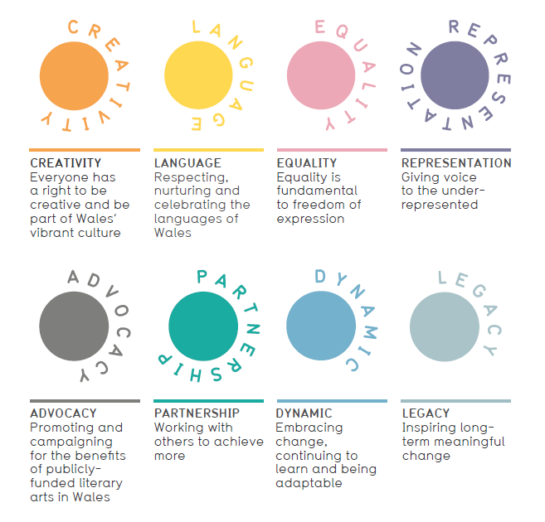
Operational Department
Highlight: Sector Facilitation
From sharing best practice with literary start-ups, to suggesting writers of all career levels for exciting external opportunities, to investing time in individuals at the start of their writing career, here are some examples of our best moments supporting the literary sector:
Supporting Individuals:
Poet, Marvin Thompson, got in touch to ask for support with developing his writing career. His poetry collection was chosen by the Forward Arts Foundation for NPD Promotions. He was keen for his poetry to be available in Welsh, so we allocated a small budget of £50 for a translator to work with him. Marvin has continued to work with translators on other projects, and his poetry about race and the #BlackLivesMatter movement has been published online. Marvin will become the first Black writer to be promoting Wales as part of National Poetry Day and represent Wales’ Literary Culture on a global scale.
Supporting Literary Groups:
We provided two literary collectives (‘Where I’m Coming From’ and ‘Y Stamp’) with in-kind space at Tŷ Newydd Writing Centre to ignite conversations between identity, race, culture and language. As a result of this initial workshop, the two groups have now formed one collective, ‘Hunan-Iaith’ that seeks to create new language through creative practice. They have since been approached by national organisations who want to support this initiative and we continue to broker relationships between the group and the sector.
Supporting Organisations:
Our Head of Development & Deputy CEO joined Wales’ Seren Books’ Board of Directors in 2019 to provide in-kind support on their strategic direction, business planning and commissioning. To date, this has led to a festival programme more representative of Wales’ literary culture, agreed commitments to increase the diversity of writers they publish and new paid editorship opportunities at Poetry Wales for writers who identify with our Target Client Characteristics.
We said we needed to better deliver for the wider literature sector.
We are doing this by moving our focus from direct delivery to facilitation, supporting others to provide literary activities for themselves and their communities.
Since April 2019…
1,000+
Hours of facilitation work has been delivered to the literature sector
789
Groups, individuals and organisations received facilitatory support
109
Partner-led projects have received facilitation or secondary partnership support
20
New self-run sustainable literary projects have been stimulated in areas of need

Slide 7

Organisational Impact & Outcomes
 | Target for 31 March 2020 | Current Progress 1 January – 31 March 2020 | Method of data capture
Organisational Impact | We will be on our way to empowering, improving and brightening the lives of our clients, contributing to their greater well-being and that of Wales’ society, economy and culture | The three year Longitudinal Survey has been created and sent to a representative sample of 10 clients, who have been contracted to complete it twice a year. Three new clients have been selected to participate in the Longitudinal Survey 2020-2023, and we will expand the sample by another 3 this year. The next analysis of the Longitudinal Survey will be available after survey #3 is completed by the clients in September/October 2020. In the meantime, we’re keeping in touch with the current sample clients as they continue to engage with Literature Wales and other organisations and professional opportunities. | 2019-22 Longitudinal Survey
Organisational Outcomes | Our clients will be on their way to having: Improved spoken and written skills Increased self-confidence Increased employability A decreased sense of isolation A decreased risk of, and increased resilience to, mental illness Exposure to new worlds, philosophies, cultures Increased ability to empathise Increased multilingual skills

Slide 8
Organisational Outputs
Activity Key Measures of Success: Participation
Targets for 31 March 2021 | Current Progress 1 April – 30 June 2020 | 20/21 Target Updates | Method of data capture
The proportion of Wales’ population participating in creative writing has increased by 1.2 percentage points from 8.2% in 2016 to 9.4% by 2021 (equating to an extra 41,400 people). | The 2020 Arts Council of Wales’ Omnibus Survey summary report found that 11.5% of adults participated in creative writing (an increase of 3.3 percentage points from 2016), which was amongst the most popular participatory art forms. | This target has increased from 0.6 to 1.2 because the ACW Omnibus Survey found the figure for 2019 was 11.5%. However, we have slightly lowered the 20/21 target due to COVID-19. | Arts Council of Wales Omnibus Survey on arts participation
At least 110,000 creative participants and audience members engage in our activity annually, compared to 82,000 in 19/20. | Since April 2020, we have engaged with 18,914 creative participants and audience members through new digital projects and commissions. Our Writers on Tour event organisers moved towards new and initiative ways of delivering their events online including Zoom broadcasts and Skype. | This target has increased from 106,000 to 110,000 for 20/21. This target will also capture digital engagements to ensure participation in our online activity is accounted for. | Our project progress and evaluation reports
At least 34% of our creative participants identify with one or more of our Target Client Characteristics, compared with around 20% in 19/20. | The Equality & Diversity form has now been finalised and distributed to a representative sample of participants. Due to COVID-19, many of the workshops have been postponed. We are in the process of establishing a framework to collect data from those who engage with our digital commissions. | This target has doubled from 17% to 34% as we increase our focus on delivering projects that prioritise engagement with our Target Client Characteristics. | Our project progress and evaluation reports and Equality & Diversity monitoring
At least 450 creative participants are directed to our writer development opportunities annually, compared with 518 in 19/20. | A total of 103 creative participants have been directed to our writer development opportunities. For example, a variety of past participants were informed of our low-cost virtual creative writing courses at Tŷ Newydd Writing Centre. | This target has increased from 17 to 450 following the successful figures in 2019 as a result of our refocused remit. | Our project progress and evaluation reports

Slide 9
Organisational Outputs
Activity Key Measures of Success: Writer Development
Targets for 31 March 2021 | Current Progress 1 April – 30 June 2020 | 20/21 Target Updates | Method of data capture
We provide at least 300 creative and professional opportunities for early career writers annually, compared to 293 in 19/20. | We have provided 41 early career creative and professional opportunities since April. This includes the writers successfully awarded a commission and the poets selected to partake in our digital poetry masterclass. | This target has increased from 140 to 300 for 20/21. Our increased focus on writer development in 2019 demonstrated our ability to provide opportunities for the writers of Wales. | Our project progress and evaluation reports
There are at least 30,000 unique page views of our online writer development information annually, compared to 35,000 in 19/20. | We have received 9,189 unique page views on our online writer development information. We’ll be working on increasing our original content for writers, since over 50% of respondents told us they’d like to see more online training and professional development advice for writers in our ‘How Can we Help?’ survey. | This target has increased from 5,000 to 30,000 in 20/21. As mentioned above, we launched a variety of new projects focused on writer development in 2019. Alongside the increased focus on this output as an activity pillar, we gained more views than expected. | Google analytics
A total of 80 young writers (aged 16-30) are provided with sustained support annually, compared to 140. | 11 young writers have been provided sustained support through our recent activity. One of the early career writers awarded a writer commission used his age as a stimulus to explore and reflect on his past experiences. | This target has increased from 4 to 80 for 20/21. Our intensive focus on early career writers afforded us a high rate of engagement with young writers under 30 years old. | Our project progress and evaluation reports

Slide 10
Organisational Outputs
Activity Key Measures of Success: Wales’ Literary Culture
Targets for 31 March 2021 | Current Progress 1 April – 30 June 2020 | 20/21 Target Updates | Method of data capture
At least 200 established writers and 250 literary works are engaged in high-profile projects annually, compared to 250 and 244 respectively in 19/20. | 33 established writers and 37 literary works have engaged in our high-profile projects. In June, Gillian Clarke delivered a digital Poetry Masterclass to seven poets which included a reading from Mona Arshi to inspire the poets’ work. The seven individuals had the opportunity to further develop the shape, music and imaginative possibilities of their work. | This target has increased from 15 and 17 to 200 and 250 respectively for 20/21. Amongst our ambassadorial projects, creative writing courses and high-profile events, we engaged with a higher number of writers and literary works than expected in 2019. | Our project progress and evaluation reports
We will collaborate on and facilitate at least 20 partnership and exchange projects outside Wales annually, compared to 21 in 19/20. | We have collaborated on and facilitated 3 partnership and exchange projects outside Wales. In April, our CEO took part in ‘Mothertongues’, a digital discussion focused on the idea of language from a Welsh, Scots Gaelic and Irish language perspective. The event was delivered in partnership with British Council Wales, Welsh Government and British Council Ireland. | This target has increased from 2 to 20 as we engaged with a number of projects outside of Wales in 2019. Therefore, as a result of new partnerships, we expect to continue our international activity.
Through our intervention, at least 35 commissions per year are awarded to established writers by other organisations, compared to 43 in 19/20. | Through our intervention, 23 commissions have been awarded to established writers by other organisations. In May, Bardd Plant Cymru was commissioned by the Urdd to write a poem (Cywydd Croeso) for the Eisteddfod T digital Eisteddfod. Click here to listen. | This target has increased from 2 to 35. We found that this output was a key way to encourage others to promote our literary culture, so we will continue to strive for an increased number of commissions.
A minimum of 24 early career writers engage with our high-profile opportunities annually, compared to 54 in 19/20. | 2 early career writers have engaged with our high profile opportunities since April 2020. | This target has increased from 2 to 24. As demonstrated in 2019, projects such as the Children’s Laureate Wales will enable us to achieve this.

Slide 11
Organisational Outputs
Operational Measures of Success: Monitoring & Evaluation
Targets for 31 March 2021 | Current Progress 1 April – 30 June 2020 | 20/21 Target Updates | Method of data capture
70% of our data from our activity and operational projects is stored in our central monitoring & evaluation (M&E) hub | The data stored in our central M&E hub has increased by approximately 5 percentage points in the above period (from 65 to 70%). We have slightly altered our evaluation approach for 20/21 for our projects in response to COVID-19. For example, the writers who were awarded a commission were tasks with completed an evaluation portfolio template to inform us of expected dates to receive data. | This target remains the same for 20/21. We will continue to collect figures from staff on a monthly basis for Organisational Reporting requirements. | Our project progress and evaluation reports and annual MARCOMMs survey
1 Annual Report communicating our impact has been circulated | We are currently planning the 2019-2020 Annual Report with financial statements, which will be publicly available in autumn 2020. We will also launch a soft campaign with headline data in mid-summer. | This target remains the same for 20/21.
12 monthly and 4 quarterly evaluation reports have been produced | This is the first quarterly evaluation report of 20/21. We are trialling new content to include (e.g. spotlight on a operations department) to further showcase progress to our Board of Directors, the Arts Council of Wales and our clients. We have now established a simple format for the SLT to receive a monthly progress report during 2020/2021. | This target remains the same for 20/21.
85% of new or perennial projects are pitched to SLT, and all reference learning points from our analysis | We are revising our pitching system as a result of the changes to our delivery programme due to COVID-19. Staff have been encouraged to pitch new projects to SLT that could be of benefit to freelance writers and communities during COVID-19. | This target has slightly increased from 70% to 85%. Our new financial cost centres and tightened activity programme prevented new activity to be developed without a go ahead from SLT.

Slide 12
Organisational Outputs
Operational Measures of Success: Human Resources
Targets for 31 March 2021 | Current Progress 1 April – 30 June 2020 | 20/21 Target Updates | Method of data capture
100% staff have attended at least 2 cross-team training sessions | 15% of staff have attended 1 cross-team training session in the above period. In May 2020, three staff members participated in an Unconscious Bias workshop co-ordinated by National Dance Wales for the sector. | This target has increased from 40% to 100% in 2021. We would like all staff members to have the opportunity to participate in training sessions. | Our project progress and evaluation reports
At least 2 staff have benefitted from sustained professional development opportunities (e.g. courses) | 1 staff member is benefitting from sustained professional development during this period. Our Creative Intern is undertaking a programme of training and business mentoring as part of the Arts & Business Creative Internship Scheme. | This target remains the same for 20/21.
Staff job satisfaction ratings have increased by at least 7% | The staff well-being survey is currently on hold due to COVID-19. However, we are prioritising the well-being of staff in the current climate alongside frequently sharing resources to support the team whilst working from home. | This target has remained the same for 20/21. | Company culture analysis as part of the Staff Well-Being Plan and the PDRs
At least 5% of our employees, volunteers, contractors and Directors identify as BAME and 5% have disabilities, and 1 of these is in a senior position on the staff and Board (pending vacancy availability) | 12.2% of our employees, volunteers, contractors and Directors are individuals from Black, Asian and Minority Ethnic backgrounds and 3 of these are in senior positions. 3% of our employees, volunteers, contractors and Directors have disabilities. | This target has remained the same for 20/21. | Our project progress and evaluation reports
We will have worked with at least 7 volunteers | We have worked with 1 volunteer in the above period. A university student undertook a short internship to gain experience in the field. | This target has remained the same for 20/21.

Slide 13
Organisational Outputs
Operational Measures of Success: Tŷ Newydd Writing Centre Business
Targets for 31 March 2021 | Current Progress 1 April – 30 June 2020 | 20/21 Target Updates | Method of data capture
2 successful Trusts & Foundations grant applications for funds towards Tŷ Newydd conservation, repairs and maintenance work | No Trust & Foundation applications for conservation funds have been submitted in this period, although several are in development. | This target remains the same as 19/20. Whilst funding may be limited as a result of COVID-19, we will continue to develop and submit applications. | Our quarterly accounts and record of fundraising work
Friends of Tŷ Newydd Scheme launched, and at least 30 new Friends join | Due to COVID-19 the Friends of Tŷ Newydd scheme, which will operate alongside the Friends of Literature Wales, is currently on hold. | Whilst these targets have remained the same as 19/20, we are aware that progress will be limited whilst Tŷ Newydd is closed following COVID-19 related Government Restrictions.
New specifications of works created by architects for urgent repairs needed on the conservatory | Whilst the centre is closed due to COVID-19, works will remain on hold. |  | Our project progress and evaluation reports
2 bedrooms refurbished to a high-standard
At least 85% of Tŷ Newydd Course attendees agree that their visit helped them progress as an author, and 90% state that they will return to the centre in the future | 100% of recent attendees (pre-COVID), said that their visit helped them progress as an author, and indicated they will return the centre in the future. | These targets have remained the same. We will adapt our data collection methods when gaining feedback on our virtual courses.

Slide 14
Organisational Outputs
Operational Measures of Success: Governance & Sector Consultation
Targets for 31 March 2021 | Current Progress 1 April – 30 June 2020 | 20/21 Target Updates | Method of data capture
Survey a representative pool of at least 120 individuals from stakeholder groups and representing strategic partners at least once a year | We ran a variety of surveys in this period, focused on a variety of organisational elements (e.g. the newsletter, our activity programme) to gain insights from stakeholders. We received over 460 responses from our clients. The second annual stakeholder survey will launch in November/December 2020. | This target has increased from 70 to 210 following the success of our first official stakeholder survey. | Our project progress and evaluation reports
Interview or discuss our work with a representative network of at least 18 Critical Friends at least once a year | There have been 2 Critical Friends meetings during this quarter. The Senior Leadership Team will reassess their current network in 2020/2021 to identify opportunities to recruit new Critical Friends. | This target has slightly increased from 15 to 18 for 20/21 as we hope to recruit additional Critical Friends.
Convene 3 Management Board Advisory Group meetings, 15 SMT Operations meetings and 2 cross-staff Creative Planning session annually | 3 Management Board Advisory Groups (COVID-19 Emergency Board Meetings) and 35 SMT Operations Meetings (COVID-19 Meetings every other day) were convened. We are exploring options on how best to hold our Creative Planning days digitally. | These targets have increased from 2, 10 and 1 to 3, 15 and 2 respectively for 20/21. Whilst they may be digital meetings, we are confident we can achieve these figures.
Share analysis of stakeholder feedback via monthly and quarterly evaluation reports, and reference it in decision-making | We have continued to share analysis of stakeholder feedback within our quarterly evaluation reports, and reference it in the CEO Report. This report features a page on the insights of our most recent stakeholder surveys. | This target has remained the same for 20/21. | Project pitches and meeting minutes

Slide 15
Organisational Outputs
Operational Measures of Success: Sector Facilitation
Targets for 31 March 2021 | Current Progress 1 April – 30 June 2020 | 20/21 Target Updates | Method of data capture
Directly deliver no more than 10 projects annually | We have paused the majority of activity projects as a result of COVID-19. A new and updated Activity Programme has been established and will continue to be developed as our financial situation becomes clearer for 20/21 and 21/22. We currently have 14 activity project budgets active, and 9 of these are directly delivered projects. | This target remains the same for 20/21. Whilst we are unsure of what our programme of activity will look like, we will not directly deliver more than 10 projects. | Our project progress and evaluation reports
Intensively support at least 30 partner-led projects as facilitators or secondary partners annually, and support another 70 with general in-kind support. | We have intensively supported 3 partner-led projects and provided 8 general in-kind support in the above period. For example, we have been working with the National Centre for Learning Welsh and the Hununiath Creative Collaborative to explore how writing could contribute to creating Welsh-language learning resources regarding #BlackLivesMatter and wider vocabulary around race and identity. | This target has been changed from 20 to 30 for 20/21. In addition, this target will now separate those projects that receive intensive support from Literature Wales, and those who receive general in-kind provision.
Provide funding and/or in-kind support to at least 700 individuals, groups and organisations annually | During the above period, we provided 90 hours of funding or support to 71 individuals, groups and organisations. We are currently working with a range of organisations to develop ideas for Raymond Williams’ Centenary in 2021. We have met with stakeholders, participated in working groups and made introductions between groups and organisations. | This target has increased from 150 to 700 for 20/21. Our increased focus on sector facilitation alongside our new database that records this activity in 2019 resulted in us proving more facilitatory support than expected.
Have stimulated at least 10 new self-run sustainable literary projects in areas of need | We have stimulated 3 new self-run sustainable literary projects in areas of need since April 2020. | This target has increased from 4 to 10 for 20/21 as we stimulated more projects than expected in 2019.

Slide 16
Evaluation
Organisational & Operational Learning Points
Organisational Learning 1 April – 30 June 2020
The COVID-19 Government restrictions have increased our resilience to, and confidence in, working remotely and interacting digitally as a team. During the staggered return to the office, we will ensure we strike the correct balance for our staff members to continue to work from home. Remote working has also widened appetites to engaging with stakeholders through digital channels. As the COVID-19 restrictions ease, we will encourage staff to continue to utilise digital communication. This will significantly reduce costs and the carbon footprint associated with travel, meetings and venue hire. We need to continue to support the well-being of our staff throughout the transition stage of returning back to the office. Alongside consulting with staff, we will consider individual circumstances to ensure the team feel safe at work. Our Strategic Plan 2019-2023 continues to provide us with a clear remit, rationale and set of values to evidence and support decisions that may be challenged by external stakeholders.
Operational Projects 1 April – 30 June 2020
We received over 400 responses to our newsletter survey which aimed to inform the development of our MARCOMMs Plan 2019-2023. We now need to maximise this communication channel and develop exciting and targeted content to our current audience. The development of our radically new and improved Safeguarding Policy demonstrated the importance in approaching organisations with specialisms (e.g. Cardiff Third Sector Council) for in-kind support to ensure our procedures surpass expectations. Our updated Environmental Policy has provided a clear approach to altering the way we function to reduce our carbon footprint as an organisation. We will consider how digital working can be integrated into how we operate as an organisation. The rigorous recent Financial Audit, conducted by a new auditor, has emphasised the importance of working with new suppliers on a regular basis to encourage new perspectives on existing judgements and demonstrate organisational transparency.

Slide 17
Evaluation
Activity Learning Points
Activity | Learning Points 1 April – 30 June 2020 | Future Actions / Recommendations
Writer Commissions | We noticed a significant difference in the nature of the applications between the first and second rounds of the Writer Commissions call-outs. We didn’t highlight our health and well-being priority and commitment to participatory work for communities in the first round, which resulted in a large number of pitches focused on developing personal work or skills. | More prominently feature any themes in call-outs.
Wales Book of the Year | We asked a member of the selection panel to step down from their role as a judge after displaying conduct that was detrimental to our values and interests as an organisation. We were aware that this could have had a negative impact on the high-profile project so we immediately produced a Crisis PR Plan and a detailed Risk Assessment which considered scenarios to ensure we were equipped to respond to any further issues. | These forward-thinking, risk minimising, tactics allow us to conduct a 360° analysis of how to navigate situations. They should continue to be our approach when making complex decisions.
Professional Development Programme | We will use the remaining 50% of Lottery funding for 20/21 to programme a Professional Development Programmes for individuals from Black, Asian and Minority Ethnic backgrounds. Whilst we are aware that we must consult with a range of individuals, groups and organisations on a range of elements, we realised that we lack relationships with potential partners/organisations representing different identities under the BAME acronym. | We will use the Professional Development Programme as a way to connect and work with potential partners that work with individuals (especially our TCCs) and strive to forge sustainable relationships to support future activity.

